Slide 1
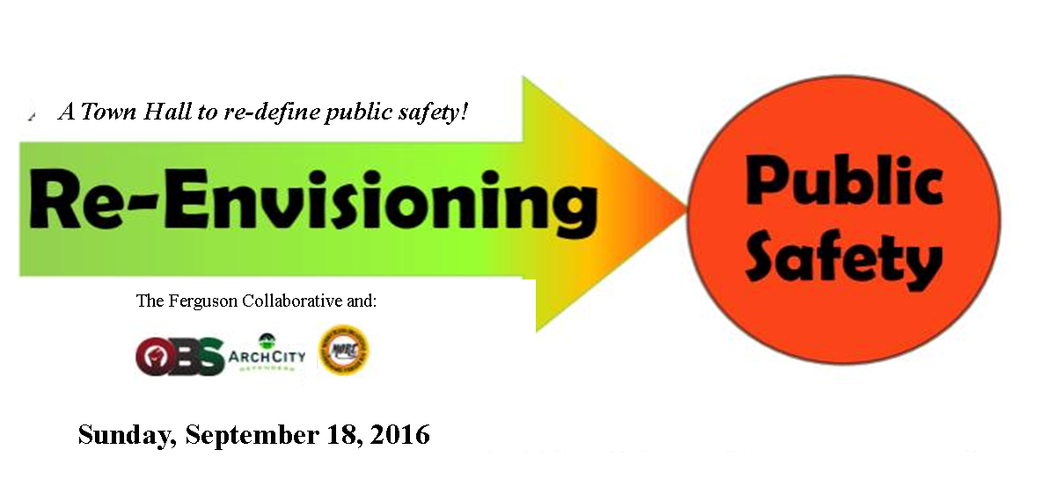

Slide 2
So…
What IS Public Safety?
Notes:
The theme today is public safety..but what exactly is public safety

Slide 3
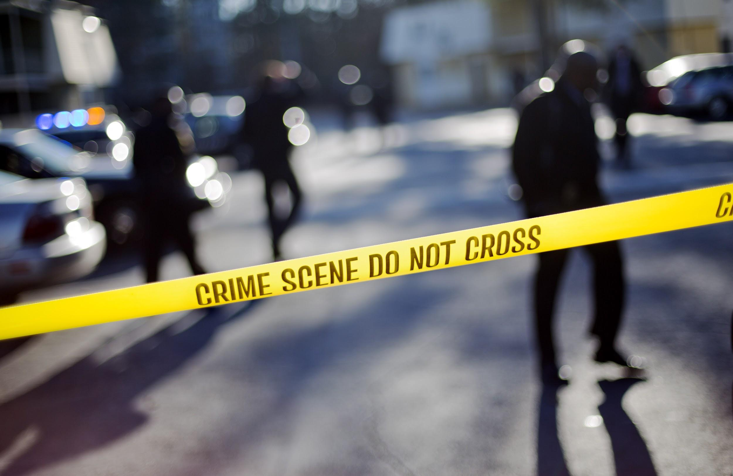
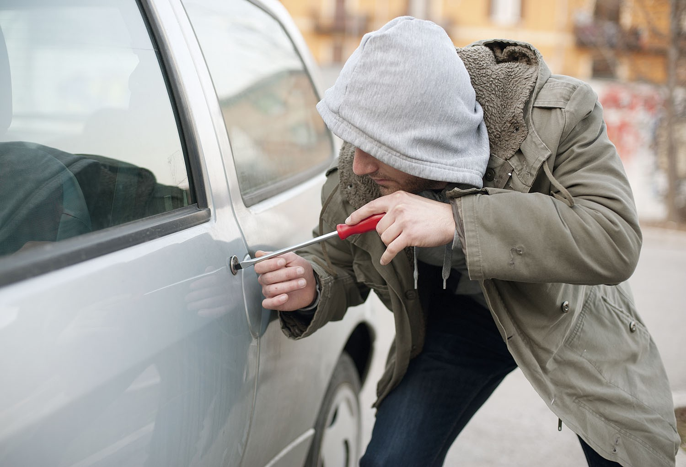
In most of our minds…
… Public Safety =
Crime Prevention
Notes:
LC

Slide 4
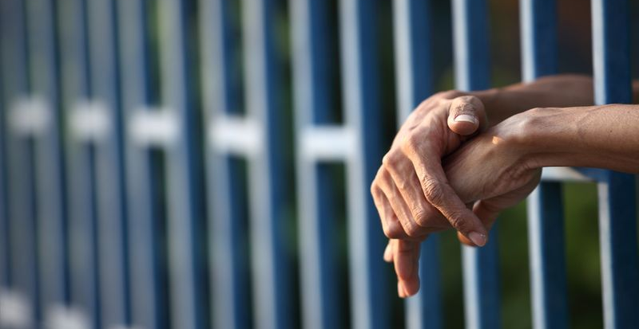
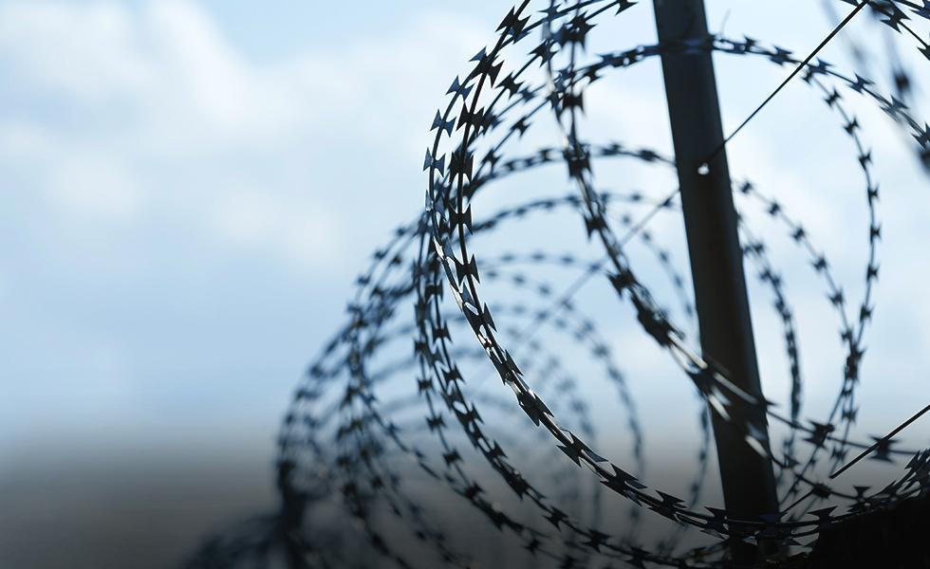
The reaction to crime for the last 30+ Years?
ARREST AND INCARCERATE

Slide 5
What has “Arrest and Incarcerate” given us?
What has Ferguson Done?
Criminalize Basketball (law against hoops)
Criminalize Walking (manner of walking)
Criminalize Teens (curfew and police in schools)
Hot Spot Policing
Flooding “certain” neighborhoods with police
Broken Windows Policing
Cracking down on minor offenses
Jails and Prisons overflowing and (black and brown) lives destroyed
Notes:
Do we have a quote from Knowles that could go here?

Slide 6
How Dangerous is Ferguson Nationally?
A national study says that Ferguson is not among the highest in crime rates, but it is well above national averages.*
*http://www.city-data.com/crime/crime-Ferguson-Missouri.html

Slide 7
How Dangerous is Ferguson? (Cont’d)
When comparing Ferguson crime rates to nearby cities, Ferguson is not among the highest crime rates, like Kinloch and Belridge, but again is well above the average.

Slide 8
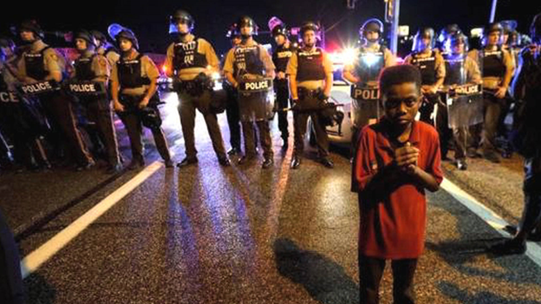
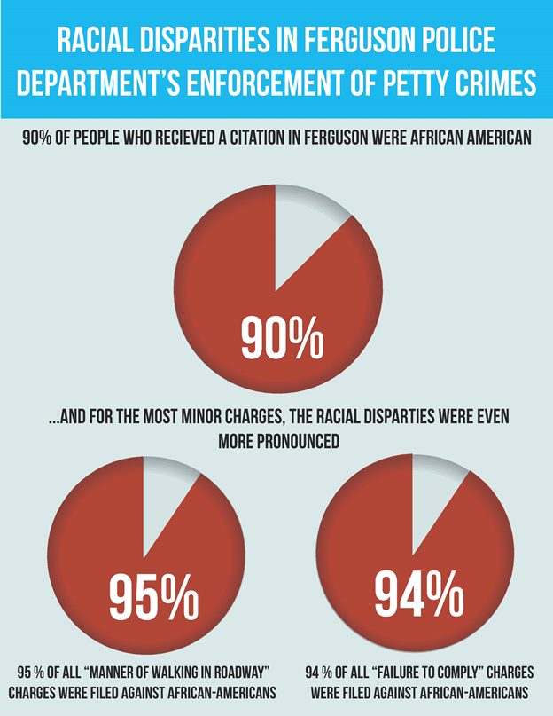
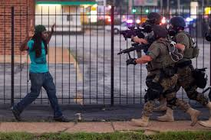
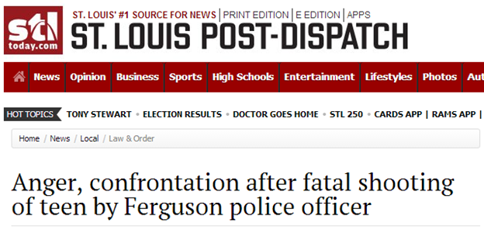
Is it working?
Notes:
What are crime stats in Ferguson? Are they going up? Need headlines on unconstitutional policing; check federal database for Ferguson stats; maybe county page
Emily working on visuals and John will track down stats

Slide 9
Police Per 10K People
Ferguson Aiming for: 49 Police
Police Per 10K People: 24.9
For Cities of this size, average is 20*
Florissant: 17.3
Berkeley 52.2
Hazelwood 25.8
* http://www.theiacp.org/Portals/0/pdfs/Officer-to-Population-Ratios.pdf
Police Per10K People, Ferguson: 24.9
Notes:
Is this helpful? How much is required by consent decree supervisor structure?

Slide 10
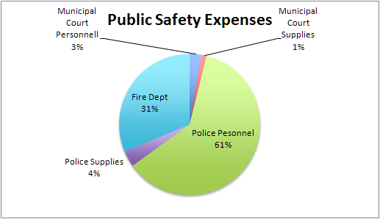
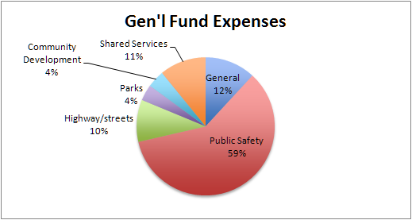
This approach distorts our budget
Public Safety: 59% of General Fund Police: 65% of Public Safety Expenses
Notes:
Denise working on this. We have the link for 2015-16.

Slide 11
Cost of the Arrest & Incarcerate Model
Municipal Court 230,700
Municipal Court Supplies 102,100
Police 5,284,700
Police Supplies 317,200
Facilities (Police portion) c. 64,450
Notes:
Denise working on this.

Slide 12
Total Arrest + Incarcerate System*: $5,999,150
General Operating Fund*: $14, 509,200
% of General Fund*: 41%
*Yearly Amounts
Notes:
kr

Slide 13
Let’s Recap...
41% of our yearly city budget goes to crime deterrence
But crime is still high, and people still don’t feel safe
City Hall’s current response is all about Police
But (especially compared to other cities), we have (or soon will have) a large enough number of police already
So what can we conclude?
Maybe we need to reevaluate what we mean by “Public Safety”...
Notes:
This slide might go, depending on the stats we find

Slide 14
Rethinking “Public Safety”
PUBLIC SAFETY is NOT ONLY Crime Response
Public Safety must proactively address root causes of crime
Currently Ferguson’s approach to Public Safety is predominantly REACTIVE, not proactive.
But what would “Proactive” Public Safety look like?
Notes:
LC
Public safety is not only crime response, but also crime prevention
To prevent crime, and lower crime rates, we must actually address the root causes of crime and criminal activity.
We’re not doing that very well in St. Louis currently
So, what would it look like to be not just reactionary, but also proactive -- addressing crime at its root causes

Slide 15
One Solution: Problem Oriented Policing
Taking Things Off Police’s Plate
With POP:
Police spend more time solving community problems and less time arresting
Police and community find the right folks to solve a given problem
Community partners might be:
Private Non-Profits (Job-Finders, Educators, Mental Health Providers)
Government Agencies (Streets Department, Parks, Schools)
Families and Neighbors
POP doesn’t ask police to do more and more; it allows them to distribute the workload.

Slide 16
Second Solution: Alternatives to Calling Police
We could reduce number of police if we called them less often: Not every “incident” needs to be a
“crime.”
Notes:
We could also look at Peter’s doc to see what people are calling about.

Slide 17
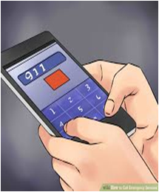
Alternatives to Calling the Police
Many communities have created community based alternatives aimed at addressing issues of public safety that do not rely on police intervention or incarceration. For decades, communities across the world have recognized the limitations and dangers of overreliance on police and punitive state policies.
Rose City Copwatch (www.rosecitycopwatch.org) standards:
democratic
accountable
transparent
reflective of real community control

Slide 18
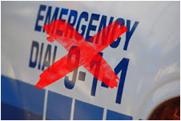
Alternatives to Calling the Police (Continued)
Things You Can Do Instead of Calling the Police
Call a friend, not the cops. Many of us can learn de-escalation, community mediation.
Create Restorative Justice Projects.
Facilitate Gang Truces.
Call a Neighborhood meeting to solve a common problem.
Divert funding from local police department budgets and direct them toward programs and services for young people that are alternatives to youth suppression.
Build community knowledge and train members as first responders instead of police. What if social workers walked a beat?

Slide 19
Third Solution: To proactively prevent crime/provide complete safety: An Holistic Approach
Education
Clean Water
Mental Health Services
Food & Nutrition
Youth Centers
Parks/Greenspace
Job/skills training
Healthcare
Community/social engagement
Employment opportunities
Shelter
Drug Prevention
Transportation
Notes:
Well-being, complete safety Proactive = Preventing Crime and its Causes

Slide 20
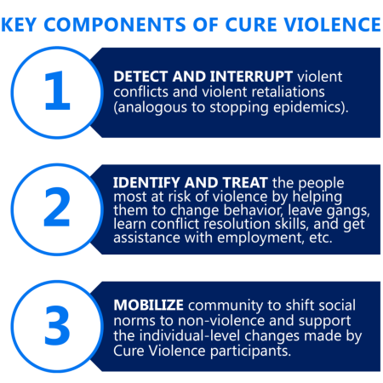
Holistic Public Safety: Evidence from For the Sake of All
How to prevent homicide and other violent (and all other) crimes?
Interventions that support:
nurturing relationships between parents and children,
conflict resolution,
job skills training,
youth mentoring, and
strategies that address unemployment and access to quality education
Notes:
Researchers wanting to deal specifically with inequities in the region looked at both the problems of crime and poverty, as well as proven solutions from across the nation.
Interventions like Cure Violence have been successful in violence prevention by using trusted community members to “interrupt transmission.”
Pg. 63 in for the sake of all report
“Neighborhood violence can affect youth in the region even if they are not personally involved in violent activity. Some parents refuse to allow their children to play outdoors or walk to and from school because of the fear of violent crime. Nearly a third of African American parents (31%) in St. Louis County say that youth violence and gang activity are serious concerns.
(For the Sake of All report, pg. 63)
The overall homicide death rate in 2011 among African Americans is more than twice as high in St. Louis City (53 per 100,000) compared to St. Louis County (24 per 100,000).187 A large proportion of the homicide deaths in 2011 among African Americans in both the County (90%) and City (87%) were due to firearms. The homicide death rate among African Americans in St. Louis County and St. Louis City combined is more than 12 times higher than the rate for whites. Interventions that support nurturing relationships between parents and children, conflict resolution, job skills training, youth mentoring, and strategies that address unemployment and access to quality education have been identified as effective in preventing homicide and other violent crimes.There are also interventions like Cure Violence (see description in box to the right) that have been successful in violence prevention by using trusted community members to “interrupt transmission.”
Cure Violence -- originally established under the name Cease Fire, Inc., the org was credited with helping to reduce crime in its target area by 67% in its first year. The Cure Violence Health Model adapts methods used to stop the transmission of some of the most deadly diseases, including AIDS, cholera, and tuberculosis. These disease control methods work by 1) interrupting transmission of the disease, 2) reducing the risk of the highest risk, and 3) changing community norms.

Slide 21
Holistic Public Safety: Evidence from For the Sake of All
Mental Health Impacts Public Safety Impacts associated with poor mental health include economic impacts: * Crime, * Imprisonment, * Reduced Earnings and Employment, and * Family Disruption.
Poverty Impacts Public Safety Included among the challenges of living in a neighborhood with high poverty:
limited availability of high-quality services and amenities.
For ex., high-poverty neighborhoods are more likely to have fast food chains, liquor stores and convenience stores instead of grocery stores, as well as greater exposure to pollution and violent crime.
Notes:
Image from pg 29 of For the Sake of All report
Mental Health “Eliminating racial and ethnic differences in mental health could save as much as $27 million in inpatient hospital charges. Other economic impacts associated with poor mental health include crime, imprisonment, reduced earnings and employment, and family disruption.”
Poverty in neighborhoods Impacts Public Safety “Neighborhoods with high poverty can be very challenging places to live a healthy life. One of these challenges is the limited availability of high-quality services and amenities. For example, studies suggest high-poverty neighborhoods are more likely to have fast food chains, liquor stores and convenience stores as well as greater exposure to pollution and violent crime. Moreover, these neighborhoods are also less likely to have supermarkets, safe places for recreation, banks, or other anchor institutions to support economic stability.”

Slide 22
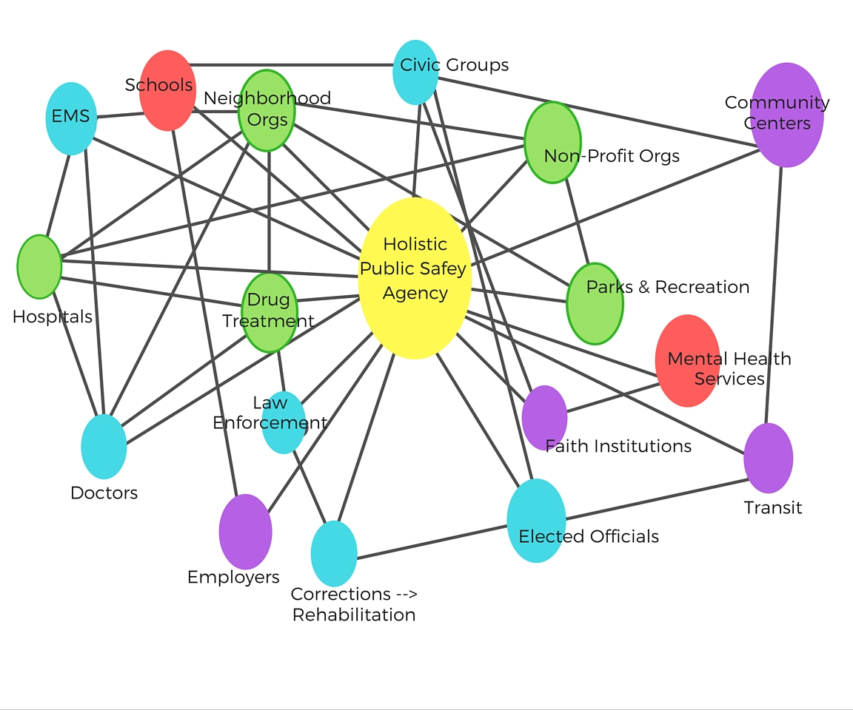
Source: http://www.cdc.gov/nphpsp/essentialservices.html
Notes:
Instead of just arrest and incarcerate, we need a whole network of essential services and resources to ensure holistic public safety for all of our communities. This web-map represents many of the different stakeholders who need to work together in order to implement holistic public safety in our communities.

Slide 23
What happens to old-style policing with Holistic Public Safety?
“Hot Spot Policing” transforms to flooding distressed neighborhoods with services
“Broken Windows Policing” turns into solving minor problems in a neighborhood (fixing street lights, turning vacant lots into gardens and playgrounds) before serious crime sets in
Police become partners in solving community problems, working with social service agencies and city departments. Their role in arresting and incarcerating is reduced as they become just one part of the solution-creating team.
Police become peacekeepers, bonding with communities and becoming part of the democratic social fabric.

Slide 24
Financing Solutions: Who’s Got the Money?
No need to spend city funds--grants and partnerships with other agencies.

Slide 25
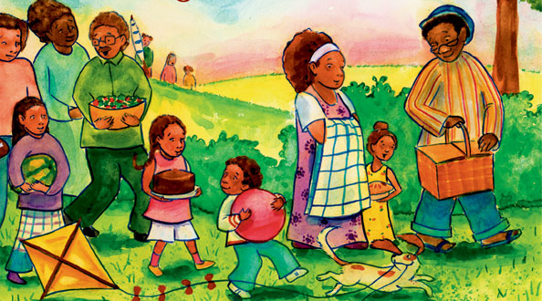
“Let’s Think about It” Activity
What does Public Safety mean TO YOU?
Would you put your energies into:
Problem Oriented Policing?
Alternatives to Calling Police?
Holistic Public Safety?
Notes:
Delete this?

Slide 26
Group Breakouts Process
Choose a topic
Huddle by topic
Assignment to specific groups
Notes:
Different Break Out Groups--Prioritizing--Metrolink? Educational tutors, drug treatment… Identifying Resources--grants and partners
Alternatives to Calling Police Problem Oriented Policing/Our Role in Neighborhood Policing

Slide 27
Links to Research
Ferguson Crime Stats
http://bit.ly/fergcrime
Problem Oriented Policing
http://www.popcenter.org/
Alternatives to Calling Police
http://bit.ly/rosecityalt
http://bit.ly/notcalling

Slide 28
Links to Research Cont’d
For the Sake of All Report
http://bit.ly/june23forthesakeofall
Budget info
http://bit.ly/fergusonbudget
Public Folder with PPT and Documents from this Townhall
http://bit.ly/fctownhall

